Slide 1
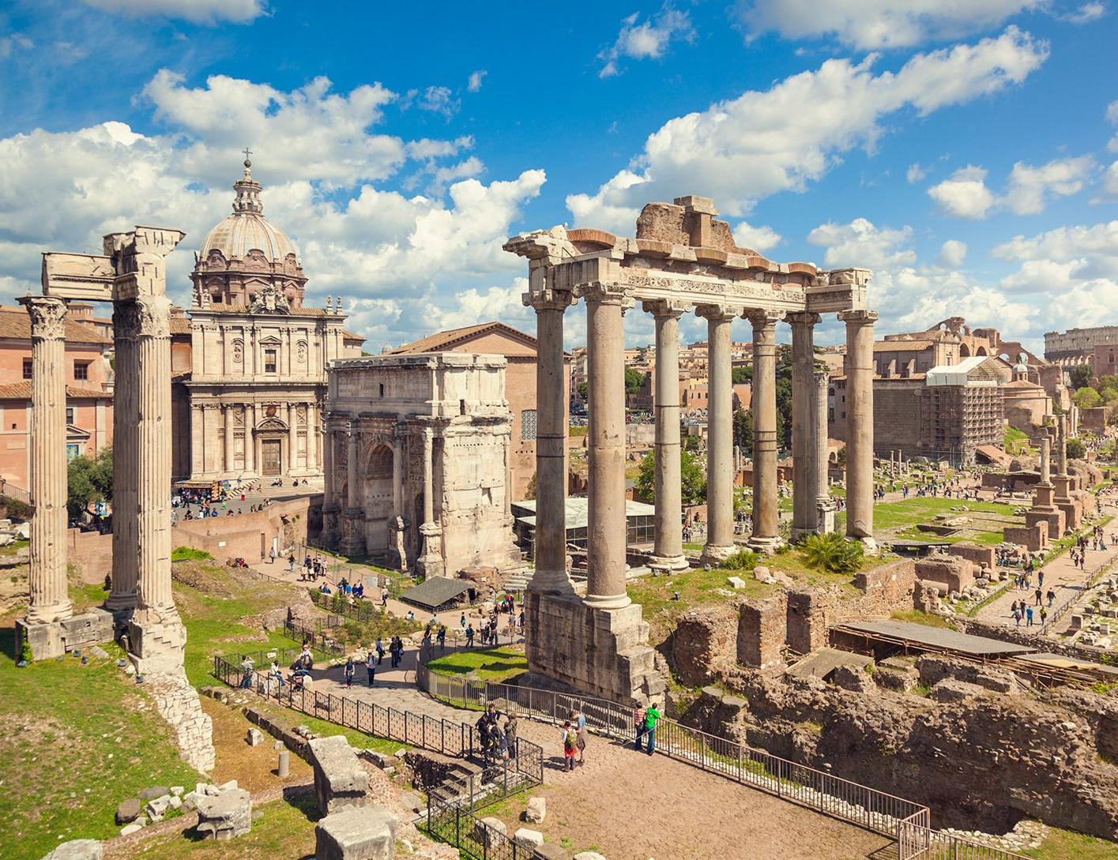
Mythology
- Describe the nature of mythology in Ancient Rome
Week 5 Lesson 4
Ms Barrie

Slide 2
The ancient Romans had a rich mythology and, while much of it was derived from their neighbours and predecessors, the Greeks, it still defined the rich history of the Roman people as they eventually grew into an empire. Roman writers such as Ovid and Virgil documented and extended the mythological heritage of the ancient Mediterranean to gives us such long-lasting and iconic figures as Aeneas, Vesta, Janus, and the twin founders of Rome itself, Romulus and Remus.

Slide 3
Deification of functions
Divine force – nonhuman phenomena (e.g. sun movement, seasons)
Gods associated with phases of life

Slide 4
Veneration of Objects
Supernatural objects
NUMEN or a ”God’s Nod”

Slide 5
Sacrifice and Magic
Forces could be allies
Sacrifice was necessary – revitalize divinity to fulfill requests
Prayer with sacrifices
Magic to coerce (e.g. festivals)
Taboo – negative branch of magic

Slide 6
What do these teach us about the Romans?
Polytheistic
Importance of ritual
Adaptation of other religions
Importance of practices

Slide 7
ACTIVITY 1 – Roman Gods
Read through the cards provided
Fill in the information about each God
10 minutes to complete this!

Slide 8

ACTIVITY 2 – Ancient Roman Monsters
Choose ONE (1) Ancient Roman Monster
Complete the research page about your monster

